Slide 1



Rescuing your GIT Repository
How to move forward when you commit and feel like you got pulled over by the cops!
Notes:
Prior to the talk
Have working “forks” of all of the demo repos:
-
-
-
-

Slide 2
















Who am I?
Brian is an experienced speaker, author, trainer, and .Net developer with
MCT (x4) / MVP (x2)/MSLearn Expert MCSD: App Builder Azure Fundamentals Azure Data Fundamentals Azure SCI Fundamentals Azure Administrator Associate Azure Security Associate Azure Developer Associate Azure IOT Developer Specialization Azure Cosmos DB Developer Specialization Azure Database Administrator Associate Azure Solutions Architect Expert Azure DevOps Engineer Expert
Brian has a masters of science degree in computer information systems, and a bachelor of science degree in computer science. Additionally, Brian has over ten years of experience instructing college courses online in SQL databases, C#/VB .Net programming, Java programming, and Microsoft Office.
Brian has also created many online video courses, available on various platforms. Recently, Brian published the second edition of his first book: Practical Entity Framework Core 6 with APress.
Brian runs a company named Major Guidance Solutions, which does contract and custom training and curriculum development. If you are interested in becoming Azure certified, make sure to connect with me.
Connect with Brian on Twitter and/or Linked In
@blgorman
https://www.linkedin/in/brianlgorman
Notes:
My name is Brian, and I’ll be your presenter for today.
I’ve been working in .Net since it was released to beta in 2001, and have been in various web development positions throughout my career, working with all the tech stacks along the way, including ASP.Net 1 and 2 Webforms, MVC, and am now looking into Blazor and Razor pages as .Net is evolving.
In addition to developing web solutions for many different companies, I have also been teaching in the Computer Science department at Franklin University since 2010 and have been developing training courses since about 2013.
I hold a bachelors in CS from Iowa State and an MS in Computer Information Systems from the UoP. I also have a number of Microsoft certifications that I’ve been earning since 2003 and recently published my first book: Practical Entity Framework with APress (with a second edition for .Net5/EFCore5 currently in progress)
Please follow me for updates and communication on twitter or Linked In. Twitter: blgorman
LinkedIn: brianlgorman

Slide 3
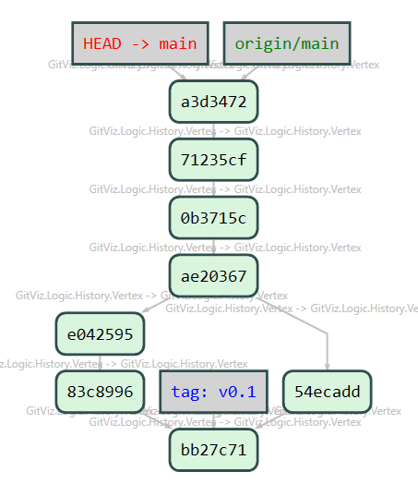
Agenda
GIT-ting started
Linear/Non-Linear/Squashing
Scenarios
1) Rebase/lost work
2) Merged two features We need only one
3) Committed to remote main Fix the mess I made
4) Committed a Secret Make it go away in all history
Conclusion
Links
Connect

Slide 4

GIT-ting started
A quick discussion and disclaimer

Slide 5
Requirements and a few notes
You should be familiar with these commands
clone/push/fetch/pull/add/commit/branch/checkout/switch
The way I’m going to show how to do things is not the only way
Follow your team standards
Let me know if you have a better way (I’d love to hear about it)
Yes, some of this is contrived for demonstration purposes
Notes:
[alias]
lol = log --oneline --graph --decorate --all
expireunreachablenow = reflog expire --expire-unreachable=now --all
gcunreachablenow = gc --prune=now

Slide 6
Interesting Global Settings
[alias]
lol = log --oneline --graph --decorate --all
expireunreachablenow = reflog expire --expire-unreachable=now --all
gcunreachablenow = gc --prune=now
[merge]
tool = code
[mergetool "code"]
cmd = code --wait --merge $REMOTE $LOCAL $BASE $MERGED
[mergetool]
prompt = false
keepbackup = false
Notes:
[alias]
lol = log --oneline --graph --decorate --all
expireunreachablenow = reflog expire --expire-unreachable=now --all
gcunreachablenow = gc --prune=now
[merge]
tool = code
[mergetool "code"]
cmd = code --wait --merge $REMOTE $LOCAL $BASE $MERGED
[mergetool]
prompt = false
keepbackup = false

Slide 7


Thank the sponsors and the team
Conferences and Code camps are hard work!
Be excellent to each other
Become a producer and not just a consumer

Slide 8
Notes:
Sponsor slide

Slide 9
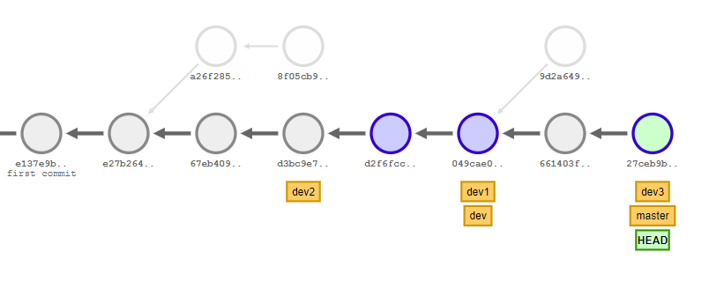
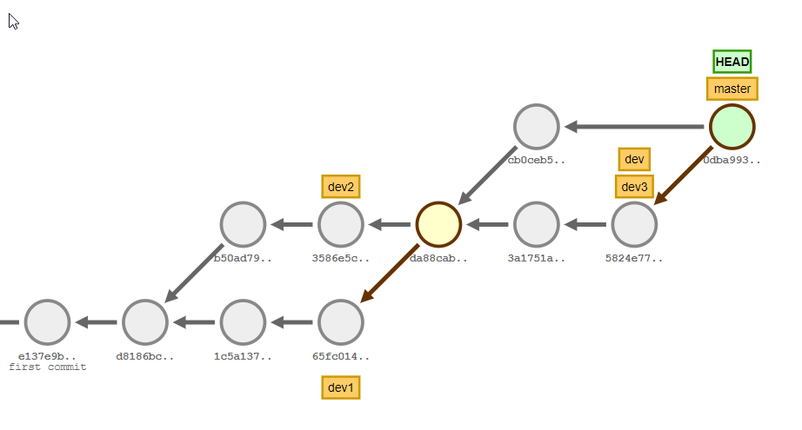
Linear and Non-Linear
Which do you prefer?

Slide 10

Traditional Merging
Any branch strategy
Non-linear commit history
Super easy to integrate team members with little or no GIT experience
Managed easily with pull requests
You can always know the exact state of your codebase when you started your development
Notes:
Counter points
Any branching leads to Long –running branches
Non-linear commits mean Many “paths” makes for a bit of spaghetti
Easy to integrate inexperienced team members ->
It is more difficult to reset a merge commit than a typical commit
Other advanced operations like picking and squashing can cause some confusion with history
Team members don’t typically understand how to work with commit history and just always roll forward
https://onlywei.github.io/explain-git-with-d3/#zen
git checkout -b dev
git commit
git checkout -b dev1
git commit
git commit
git checkout dev
git checkout -b dev2
git commit
git commit
git checkout dev
git merge dev2
git merge dev1
git checkout master
git merge dev
git checkout dev
git checkout -b dev3
git commit
git commit
git checkout dev
git merge dev3
git checkout master
git commit
git merge dev

Slide 11
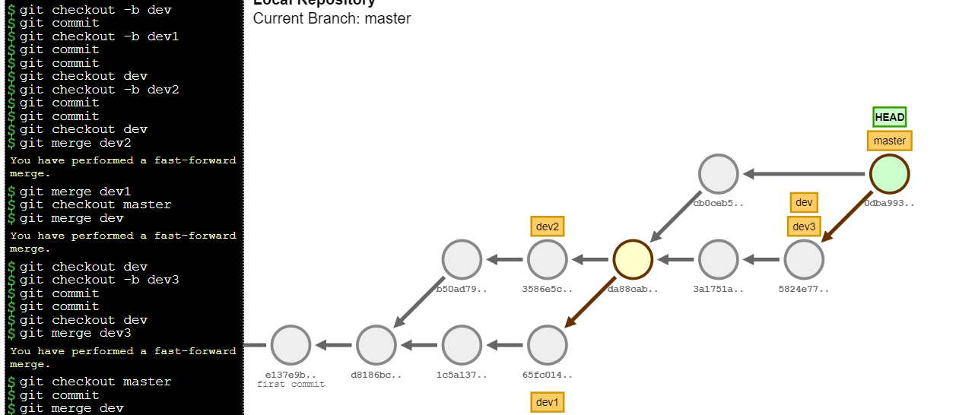
Demo: A traditional merge strategy
Multiple “branch” commits are merged with fast-forward strategy, and this leads to a non-linear history

Slide 12
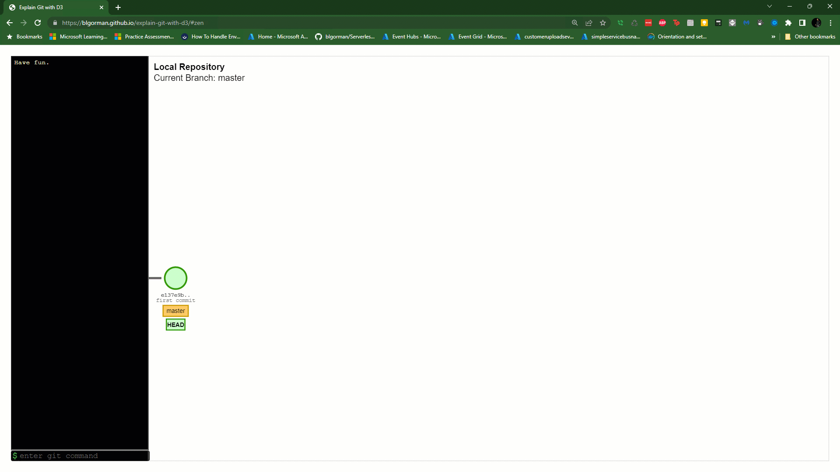
Demo: A traditional merge strategy
Multiple “branch” commits are merged with fast-forward strategy, and this leads to a non-linear history

Slide 13

Linear Commit History
Any branch strategy
Linear commit history
Much better to perform advanced commands such as pick and reset
Managed with pull requests
Can be combined with squashing for a very-succinct commit history
Notes:
Counter points
Any branching but long-running branches are PAINFUL to use so it causes your team to keep their branches short-lived or updated regularly
Linear commits leads to the need to rewrite history and force commits
Typically this approach is harder and more scary for inexperienced and new to GIT developers
https://onlywei.github.io/explain-git-with-d3/#zen

Slide 14
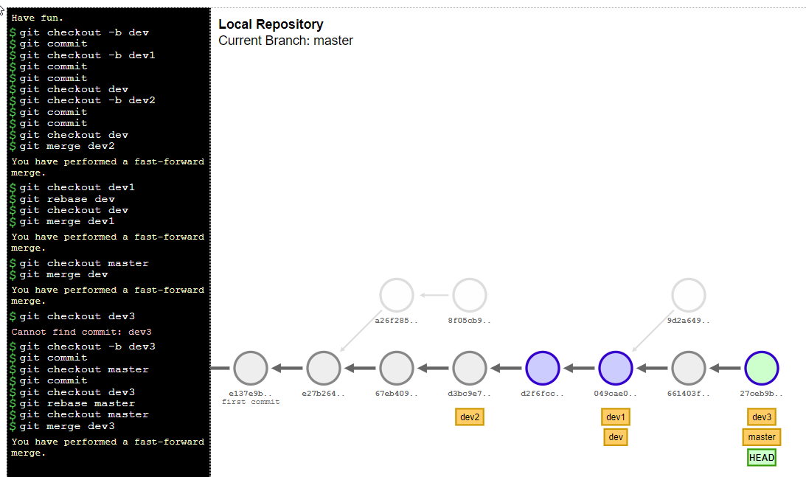
Demo: Linear Commit History
Can squash commits to make it even more concise
Notes:
Mention/point to the orphaned commits

Slide 15
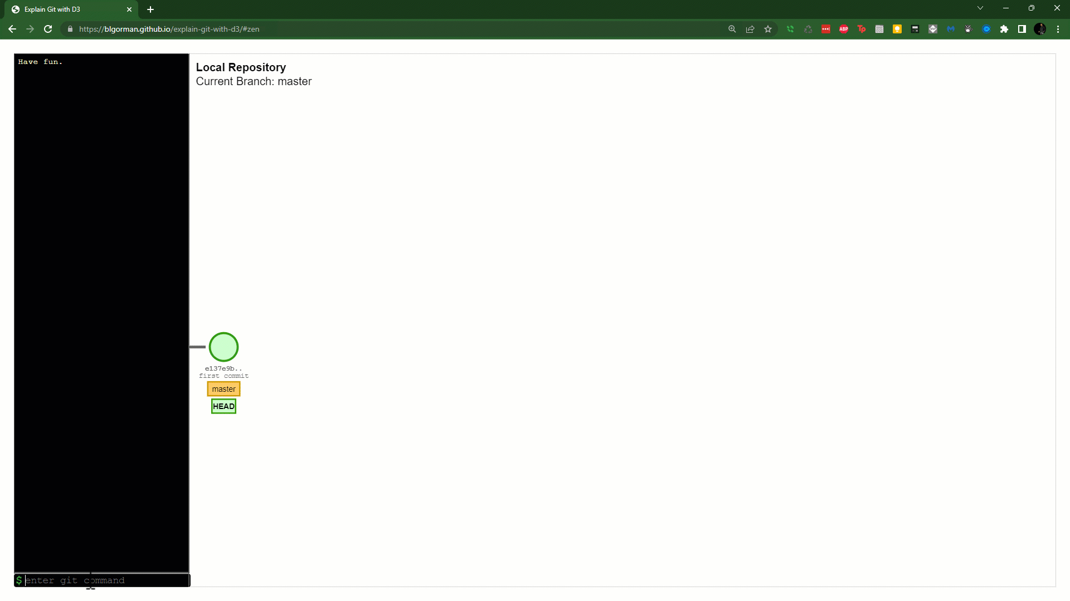
Demo: Linear Commit History
Can squash commits to make it even more concise
Notes:
Mention/point to the orphaned commits

Slide 16

Scenario #1 – Rebase Fear
I messed something up with my rebase and I think I lost work
Notes:
While the rebase demo earlier was a bit contrived, in the real world it can look/feel like you’ve lost work, especially when there is a commit rewrite with conflict.

Slide 17
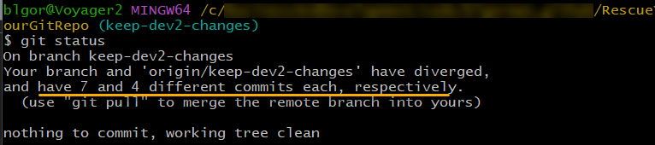
Some scary things
Your branch and origin/branch has diverged and have N and M different commits each, respectively
Might have to resolve conflicts at every commit that is being rebased, which can result in you making a mistake if you don’t resolve your conflict correctly, or the feeling that you are doing the same thing multiple times.

Slide 18
Rebase and Force push
Rebase locally, can be based on remote or local branch
Orphaned commits
Mismatched history so can’t push
Force Push (with lease)
Rebase on PR (don’t create a merge commit)

Slide 19
Demo: Force Pushing local after rebase
Your local history is correct, but remote won’t let you push. Use the force, Luke!
Notes:
Do this live if time;
If no time, just cover slides
Perhaps do both?

Slide 20
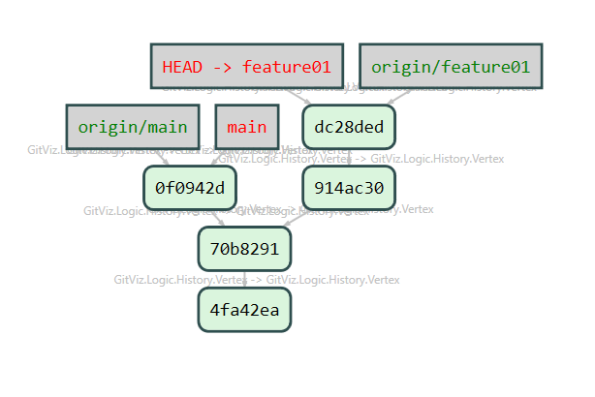
Rebase and Force Push
Another developer got changes in before you did, so you have to rebase and then force push

Slide 21
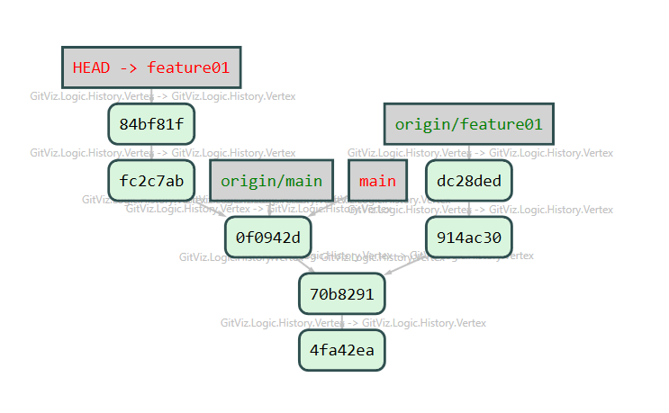
git rebase origin/main

Slide 22
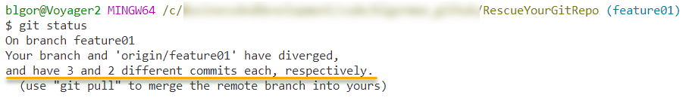
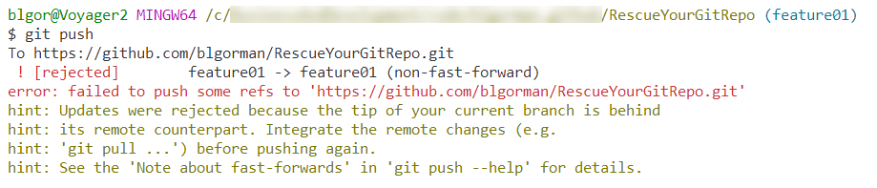
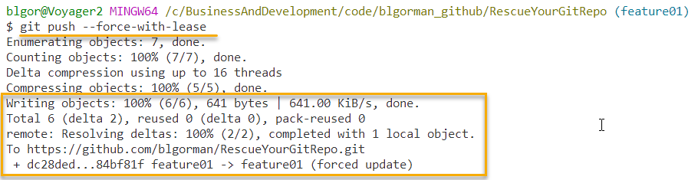
git status/git push/git push --force-with-lease

Slide 23
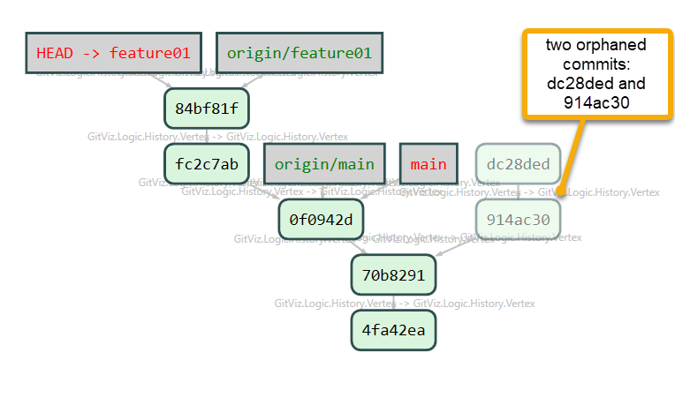
git push --force-with-lease

Slide 24
Demo: Finding Lost Commits
When you rewrite your history but need to get it back
Notes:
Scenario –

Slide 25
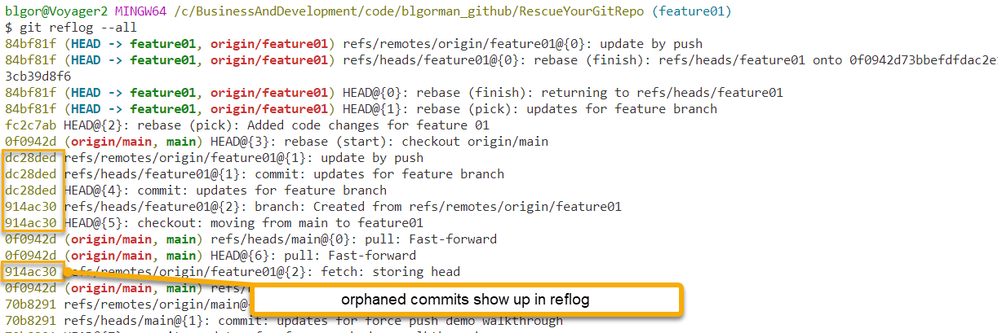
git reflog --all
Notes:
Would have been nice to show the graph log oneline to show that orphaned commits are not present in the tree

Slide 26
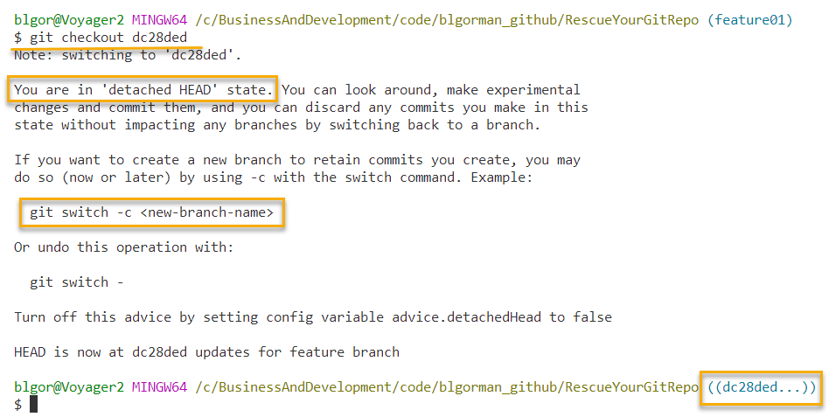
Checkout your lost commits in a detached state

Slide 27
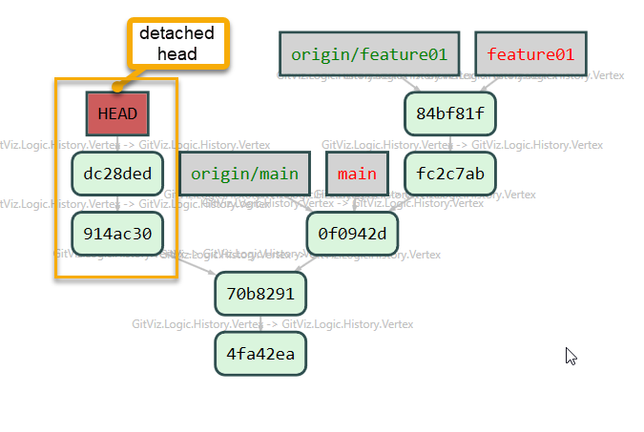
The current state (visually)

Slide 28
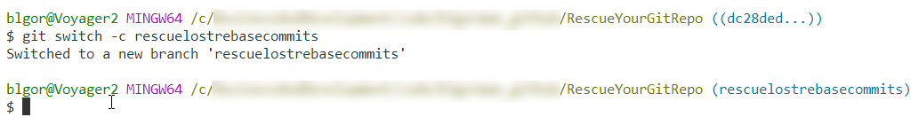
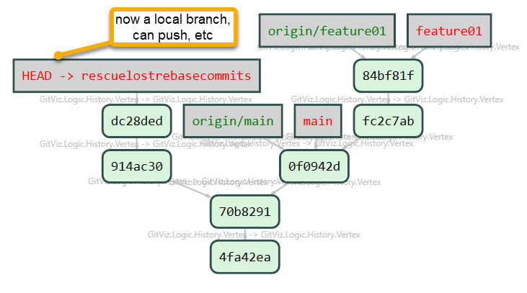
git checkout -b <new-branch-name> or git switch -c <new-branch-name>

Slide 29
Scenario #2 – Multiple Merged Features
We’ve merged multiple features, but we need one to go live right now

Slide 30
Scenario/Set up
Feature/flow-based commit strategy
Multiple devs/teams creating features
Multiple features are merged
Commit position can be directly after last release on main
Commit position can be after the feature that is not getting promoted
Requires a git reset command
May also require a cherry-pick (not the first feature)
Consider using feature flag release strategy to avoid rewriting history
Notes:
The situation is easy enough to happen in daily life. Your team and another team or you and another developer are working in parallel on features that need to go to production. Both of your features made it through code review and were merged into the main/feature branch ready to be promoted to production. When it’s getting close, suddenly feature A is no longer required, or feature B is no longer desired. Either way, only one of the features should go to production.
Depending on if you need to keep your feature code (likely), you will want to create a branch that has the commits for that feature (likely you can just make a branch from main and reset to the commits or you can reset before all the commits and pick the feature commits you want to keep. Either way, you can save the feature that didn’t go and rewrite your feature branch history so that it only contains your commits

Slide 31
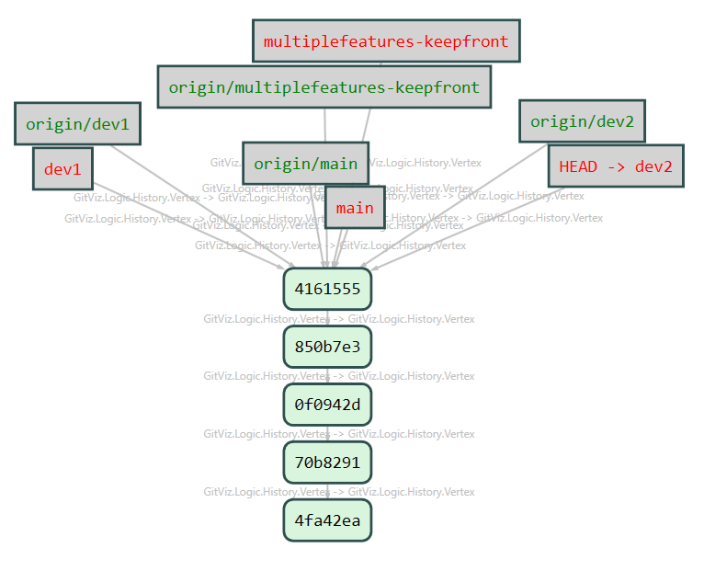
Multiple features keeping the front

Slide 32
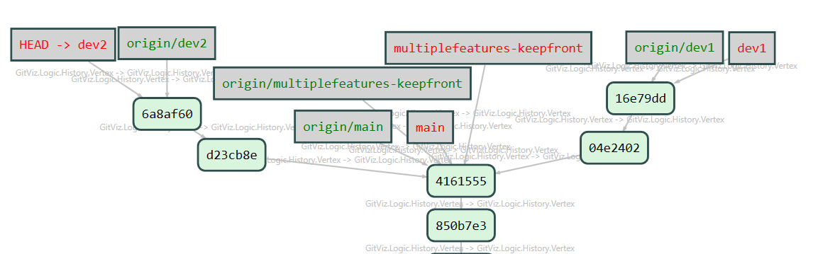
Move both dev branches forward a couple of commits

Slide 33
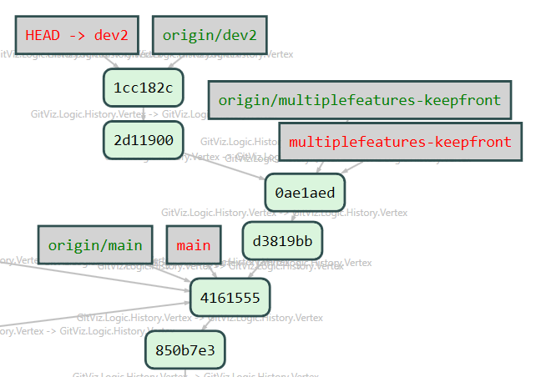
Rebase dev1 to multiplefeatures-keepfront, then delete dev1 branch then rebase dev2 on multiplefeatures-keepfront

Slide 34
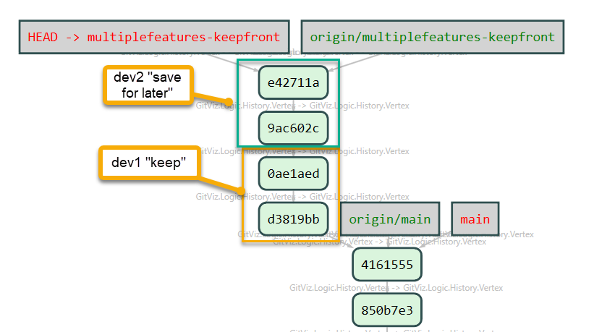
Rebase merge the dev2 branch
Notes:
This completes the setup to get to the state where only the first two commits need to be kept
Notes: You’ll have to discern in the real world. Use the ‘git diff’ command to find the changes from commit to commit to see which one has the changes you want.

Slide 35
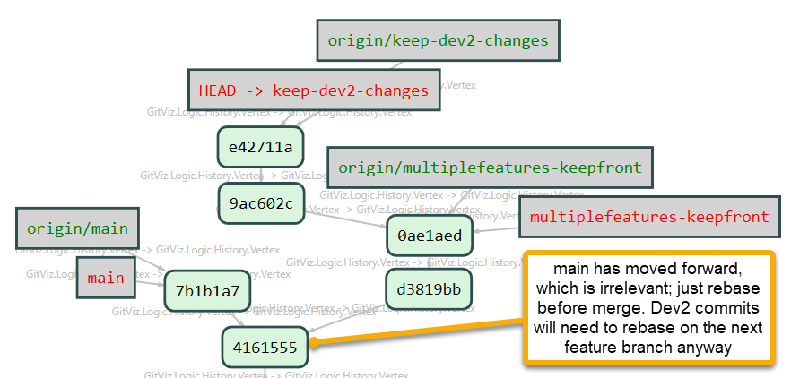
Keeping the front half (easy fix)
Create a branch to keep the back half safe
Reset the feature branch to the last commit you want to keep
Notes:
Main moved forward independent of the activity. I called it out because it might cause a question “why isn’t it based on main?”

Slide 36
Multiple Features Ready; promoting only one
Keeping the back-half will require a little surgery
Notes:
Scenario –

Slide 37
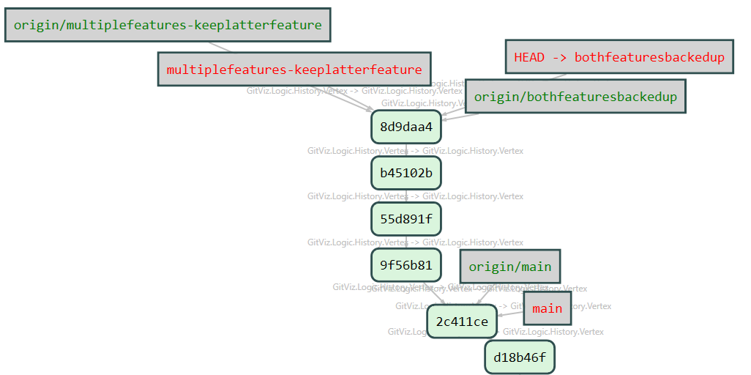
Same setup, this time keep dev2 instead of dev1 changes
Set up as before
Create a backup branch
Notes:
Set up as the first time, but this time you want to keep top two instead of bottom two
git switch -c bothfeaturesbackup
git push -u origin bothfeaturesbackup

Slide 38
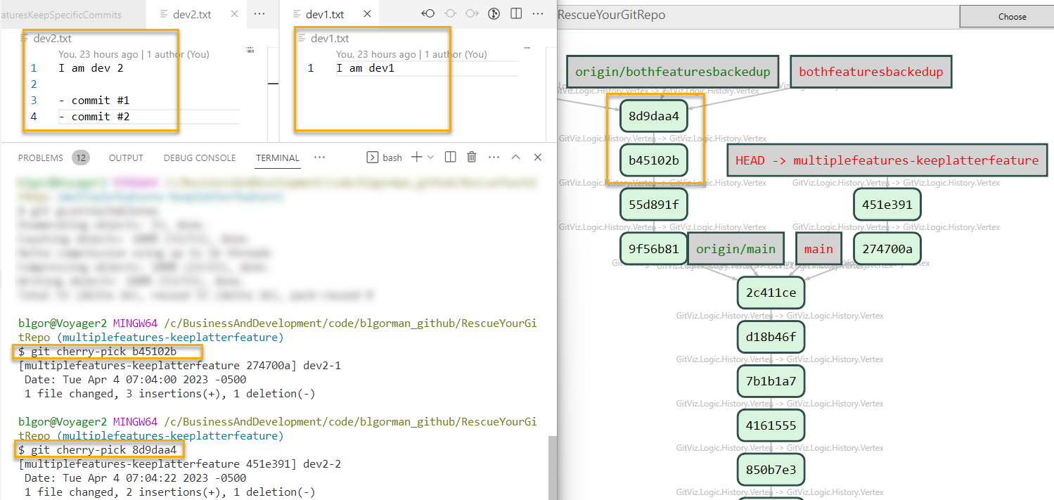
Reset the feature, then pick commits
Reset feature to main commit
Pick the commit(s) required for the feature
Notes:
git switch multiplfeatures-keeplatterfeature
git reset --hard 2c411ce
git cherry-pick b45102b
git cherry-pick 8d9daa4
git push --force-with-lease
**NOTE**: You can pick both commits at the same time if you want to see why it’s confusing during rebase
Also note: You will need to replace commit ids with the SHA from your own repo. These commands will not just work as-is in your repo as those commits don’t exist

Slide 39
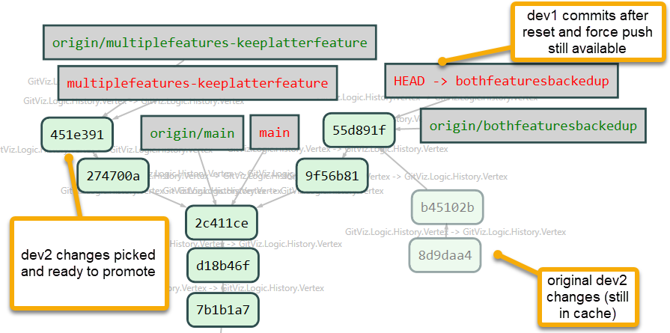
Reset backup branch to remove f2
Remove Feature 2 from the backup branch to keep only feature one
Notes:
git switch bothfeaturesbackedup
git reset --hard 55d891f
git push --force-with-lease
**Note:** the commit id is the last good commit for feature 1 that you want to keep for future development

Slide 40
Scenario #3 – Accidentally committed to remote main
After a very long day, you just wanted to go home, now you need to clean up a little mess

Slide 41

How can I fix this?
Pick your commit to a new branch
Reset main
Revert the change to keep history
Notes:
This fix is actually very easy to do. If you want the commit gone from main forever and nobody else has pulled the latest main branch, you can just create a branch, pick your commit to it, reset main and force push main
Or
If you need to keep history, just revert the change. Nothing will be harmed and the commit will be undone

Slide 42
Demo: Direct push to remote main
I accidentally pushed my changes to remote main, how can I fix this?
Notes:
Scenario –

Slide 43
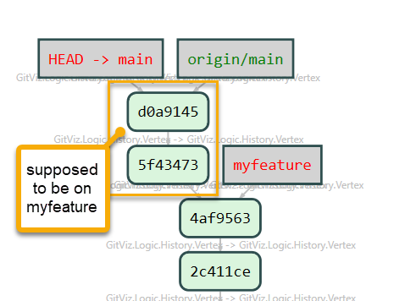
Get Set Up
Create a feature branch and/or dev branch to simulate your work
Forget to switch to the branch
Move your branch forward a couple of commits (oops….it’s on main, but you don’t notice)
Blindly push your changes assuming you are on your branch
Notes:
git branch myfeature
Make some commits
git push
Ooops

Slide 44
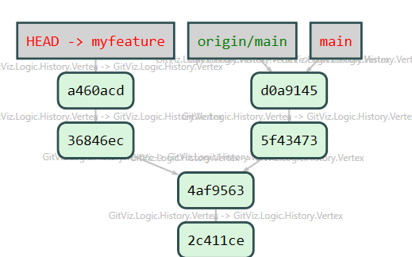
Pick the commits to your feature branch
git switch myfeature
git cherry-pick 5f43473
git cherry-pick d0a9145
Notes:
git switch myfeature
git cherry-pick 5f43473
git cherry-pick d0a9145

Slide 45
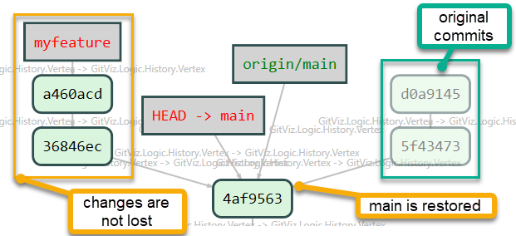
Switch to main, reset, and force push
git switch main
git reset --hard 4af9563
git push --force-with-lease
git pull --prune
Notes:
git switch main
git reset --hard 4af9563
git push --force-with-lease
git pull --prune

Slide 46
Your Team Members
They might `hate` you right now
If they are out of sync and have no changes to main other than your bad commits:
Hard reset from origin
git switch main
git fetch
git reset --hard origin/main
If they are out of sync and also made this error:
Follow the same procedure to pick their commits to their feature
Just hard reset from origin

Slide 47
Scenario #4 – Secrets in history
The secret was committed at some point, and we need it out of our history completely, to make it like the secret was never stored

Slide 48
Find the first `bad` commit, then rewrite history
Note: You will likely want to freeze development during this process, ensure that all code is checked in, and no branches are dependent on a commit in the history past the last good commit (those commits will not be there anymore when this is completed).
Use `git bisect` to find the first commit where the secret is in the repo
Once the commit is located, the fix will be to rewrite the history from that point with the secret removed.
After history rewrite, you can restore any feature branch/dev branch, etc
You can also pick any commits that are no longer based on the trunk after this operation

Slide 49
Demo: Find the place where a bug or a secret exists and rewrite from there
I accidentally checked a secret into my repo. How do I get it out of there?
Notes:
Scenario –

Slide 50
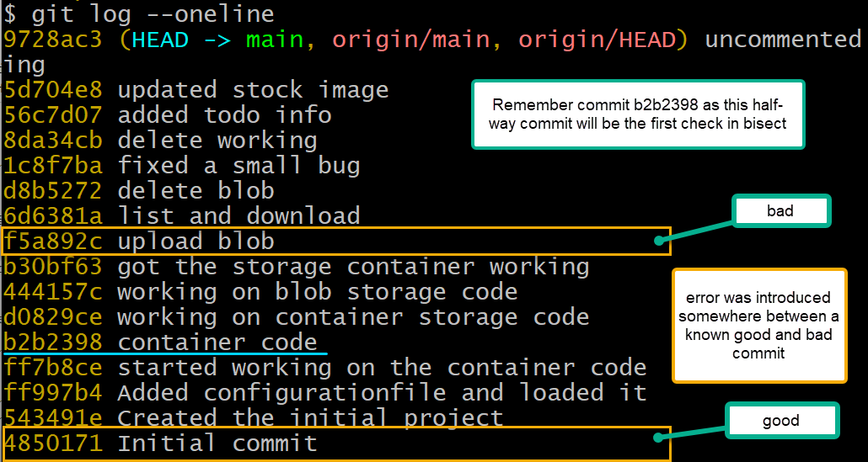
Review Commit History

Slide 51
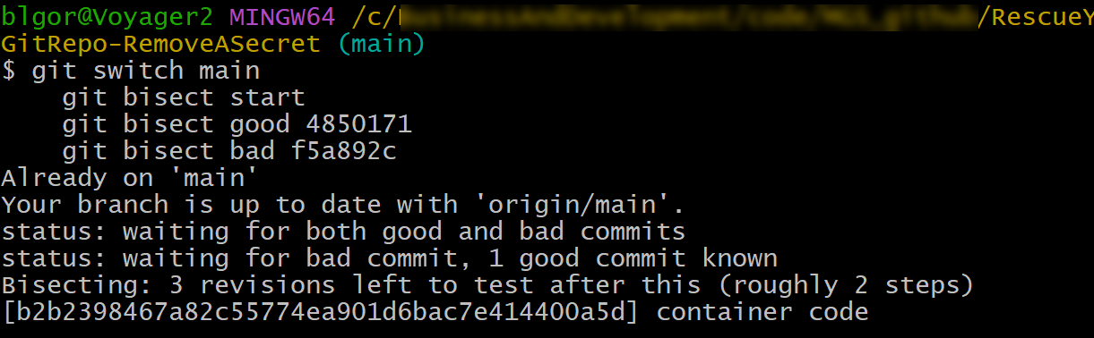
Find the first bad commit
git switch main
git bisect start
git bisect good 4850171
git bisect bad f5a892c
Notes:
Notice that it goes directly half-way between the good and bad commits named

Slide 52
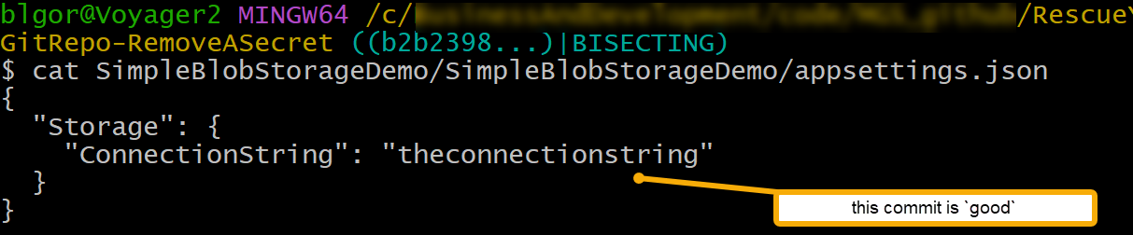
Review the file to validate if it is good or bad

Slide 53
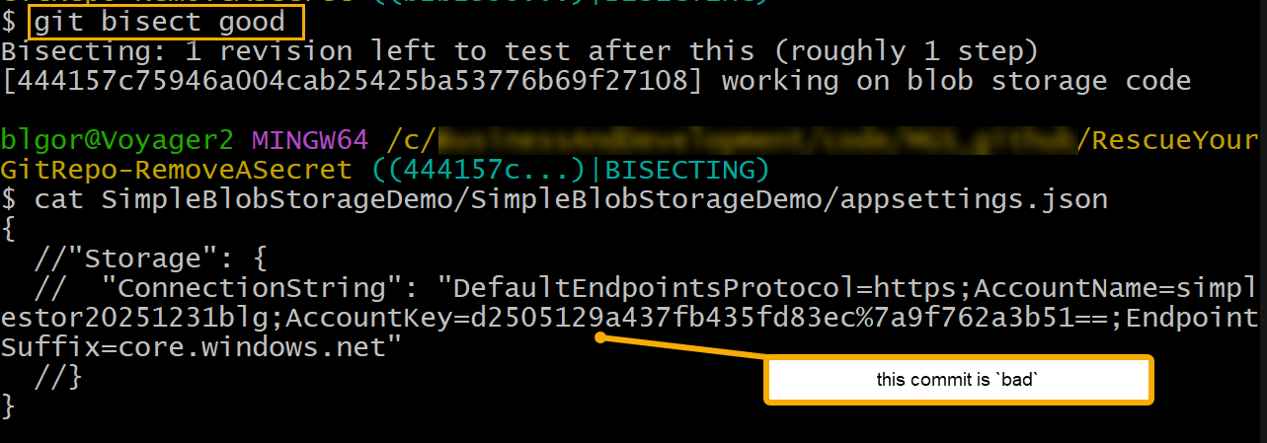
Mark commit as good, review next commit. Mark as bad. Repeat until finished
Notes:
Continue marking bad until no commits remain or you hit another good commit

Slide 54
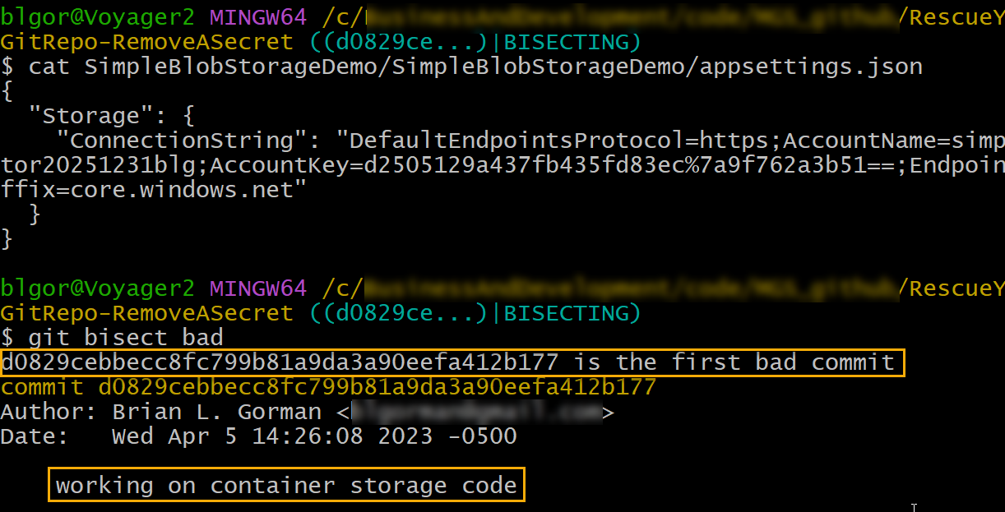
Bisect identifies the first bad commit

Slide 55
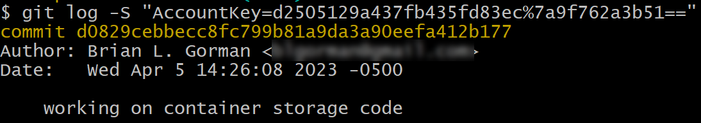
Review the log with a search
git log -S "AccountKey=d2505129a437fb435fd83ec%7a9f762a3b51=="
Notes:
Maybe a bit easier than bisect for this case.

Slide 56
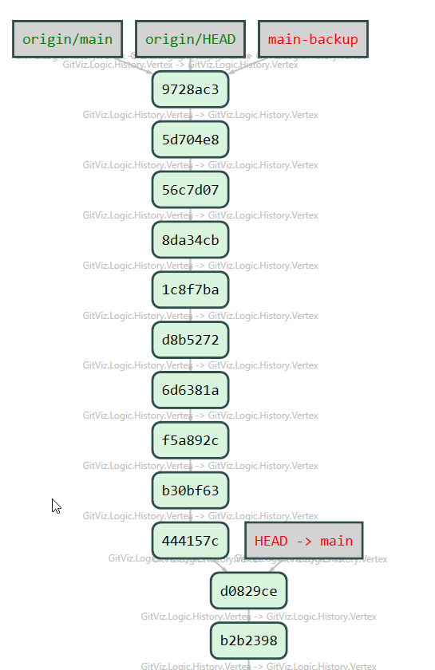
Create a backup and reset local main to the first bad commit
git switch -c main-backup
git switch main
git reset --hard d0829ce
git log --oneline
Notes:
git switch -c main-backup
git switch main
git reset --hard d0829ce
git log –oneline

Slide 57
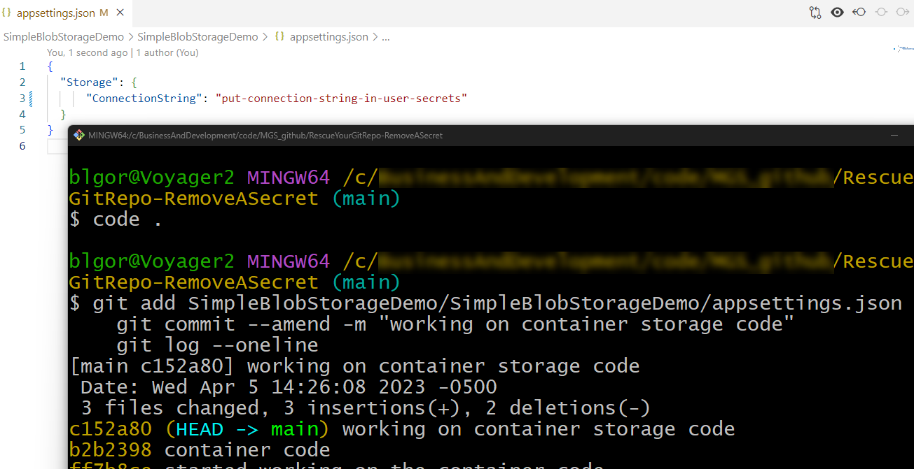
Fix the bad file and amend the commit
code .
# fix the json
git add SimpleBlobStorageDemo/SimpleBlobStorageDemo/appsettings.json
git commit --amend -m "working on container storage code"
git log --oneline
Notes:
code .
```update json
{
"Storage": {
"ConnectionString": "put-connection-string-in-user-secrets"
}
}
```
git add SimpleBlobStorageDemo/SimpleBlobStorageDemo/appsettings.json
git commit --amend -m "working on container storage code"
git log --oneline

Slide 58
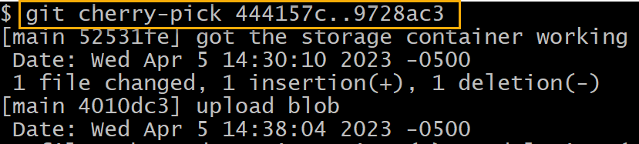
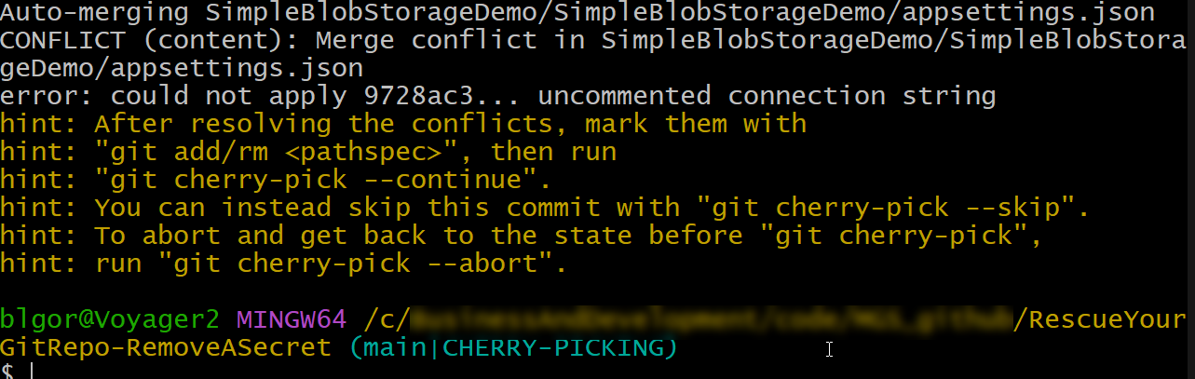
Cherry-pick the rest of the commits
Notes:
git cherry-pick 444157c..9728ac3
The pick will have a merge conflict
Make note of the HINTS, everything you need to know is in there!

Slide 59
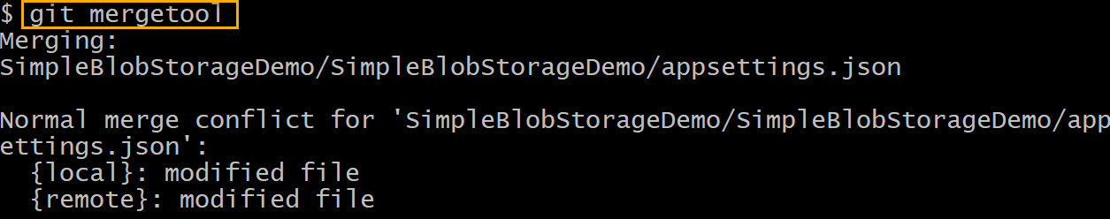
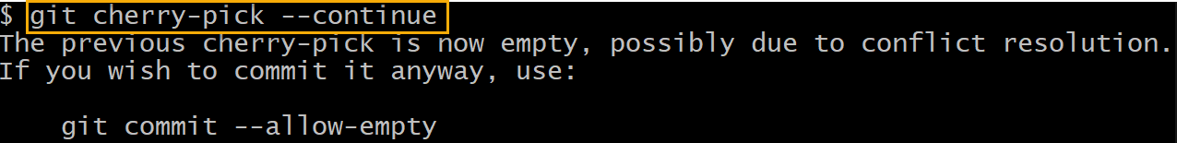
Resolve the conflict and complete the cherry-pick operation
Notes:
git mergetool
git add SimpleBlobStorageDemo/SimpleBlobStorageDemo/appsettings.json
git cherry-pick --continue
git commit --allow-empty

Slide 60
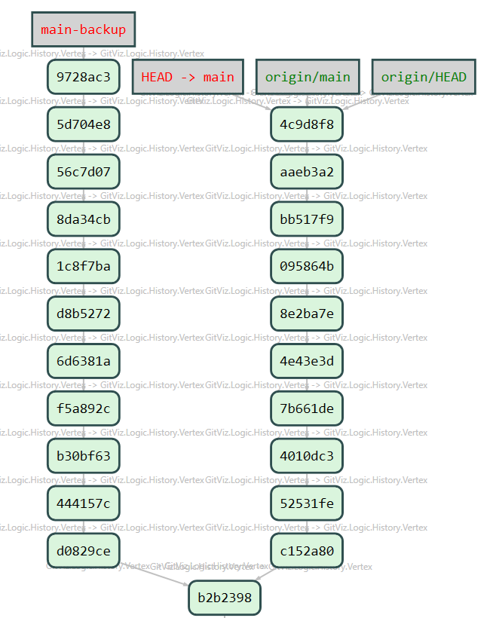
Force your changes onto remote main
git push --force-with-lease
Notes:
git log -S "AccountKey=d2505129a437fb435fd83ec%7a9f762a3b51=="
git push --force-with-lease
One less commit, likely due to the cherry-pick merge allow empty thing
No trace of the secret
Delete your backup branch

Slide 61
Summary
Consider a linear history for best results
Consider squash/interactive rebase for single commit features
Nothing is ever ruined (it’s very difficult to mess up a GIT repo)
Remember that you have a local cache of commits
Use caution and rework your history with confidence
When in doubt, create a JIC branch
Get good with GIT commands (you’ll be the hero of your team)

Slide 62

Questions?
Email:
brian@majorguidancesolutions.com
blgorman@gmail.com
Twitter
@blgorman
Linked In
https://www.linkedin/in/brianlgorman
Code:
https://github.com/blgorman/
Join an MS Learn Room:
https://techcommunity.microsoft.com/t5/custom/page/page-id/learn?fbclid=IwAR237iNIKd-q45HTw_0Yap5UXbiGE2HkCm_MS5faRiLMZu63e7tBbQ7JXvo

Slide 63
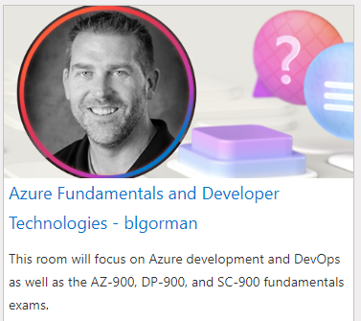

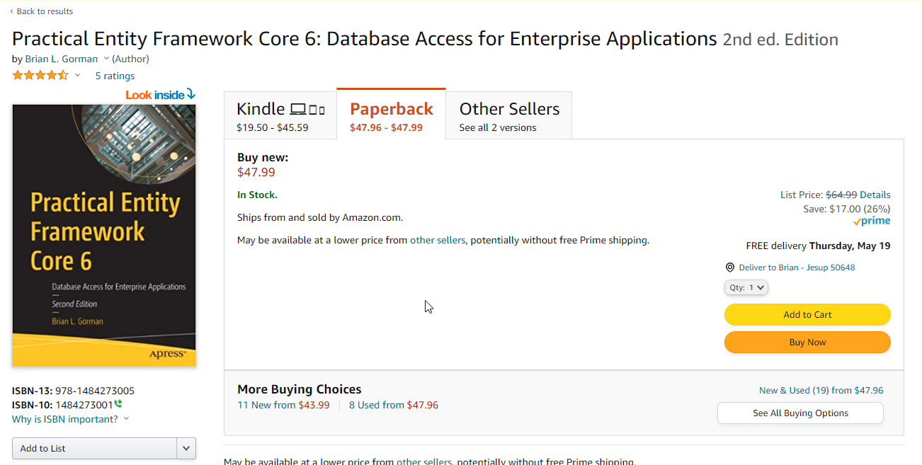

Conclusion
@blgorman
https://www.linkedin.com/in/brianlgorman
Thanks for having me today!
Notes:
Thank you for attending my talk today. Please reach out and connect.
If you liked the talk today, you can support me by listening to one or more of my songs on spotify ☺ https://open.spotify.com/artist/0rRlrvBVhAhZCHcENoiFJ0
Look for one of my books on Amazon
https://www.amazon.com/stores/author/B08MQBWN49/allbooks?ingress=0&visitId=aceaf328-e862-4292-ad9b-ff622549f2f1&store_ref=ap_rdr&ref_=ap_rdr
And/or join a learning room (mine or others)
https://techcommunity.microsoft.com/t5/custom/page/page-id/learn?fbclid=IwAR0Mq6MMG5xt31RYWdJgqsq2078qFmjQggze08GaQ3Rm9sV4qC9ARjC7ElA

